Slide 1
INTELIGENT SYSTEMS
Neural networks– Denis, kacper and kirill.

Slide 2
Introduction
In this assignment we had two robots that were fighting, and all of the battles were simulated, we had 1000 battles that took place. The expected result of this assignment is that we will obtain a result of two robots as they are trained so that we find out their strenghts and weeknesses.
We will use the encog library and we use a main class of BattlefieldParameterEvaluator to get the results.
The matrix will be written as a grayscale png, allowing for the results of the estimation to be evaluated visably.

Slide 3
Explaining Battlefield parameter evaluator
There is three classes in this class:
Environment
BattlefieldParameterEvaluator
BattleObserver
The class Environment is responsible for running the Evaluater with the amount of Samples we preditermine.
The Battlefield Parameter Evaluator creates a dataset for the robots, it created a network to be trained, it trains the dataset and does this over the sample specified, it then creates samples and evaluates them. The samples are used for plotting the graph i.e. The image at the end we obtain. In this class the image is created also.
Batlle observer is the battle listener for handing the battle events we are interested in. Whenever a battle has finished, the class provideds an output of the scores of the robots in the console. This class is also responsible for creating the battlefield as it calls the robocode library to run.

Slide 4
Encog library
The Encog Library is a Java library responsible for machine learning in Java.
Encog’s main strenght is that it supports neural network algorithms.
Encog allows us to use classes to normalize and process data for these neural networks.
Nearly all neural networks contain layers. A layer is a group of neurons that behave similarly. There are many different layer types used by the different types of neural networks that are supported by Encog.

Slide 5
Training explanation
We create a dataset and we normalize the inputs of the dataset to have an interval of the form [0,1].
We use an Activation Sigmoid function to predict our outcomes, and we use it to create the training network. The Sigmoid function is part of the Encog library. The range for sigmoid is set from 0 to 1.
The Propagation is then used to train the network that we have created and also the dataset.
The synapses and weights are adjusted in this project to find the robot’s strenght and weaknesses.

Slide 6
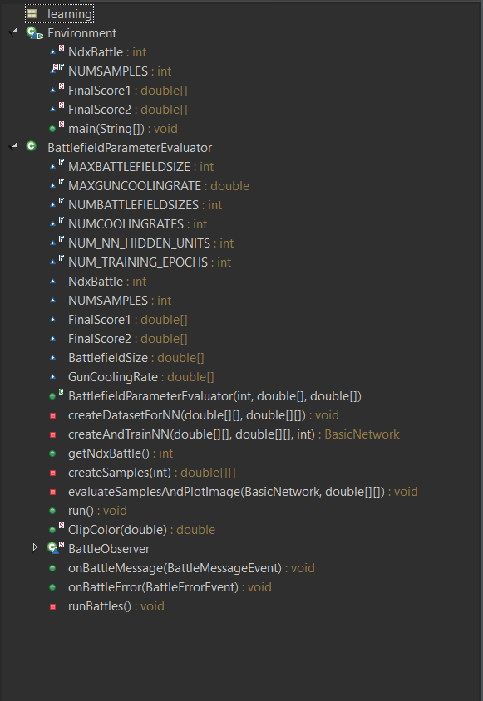
Class diagram

Slide 7
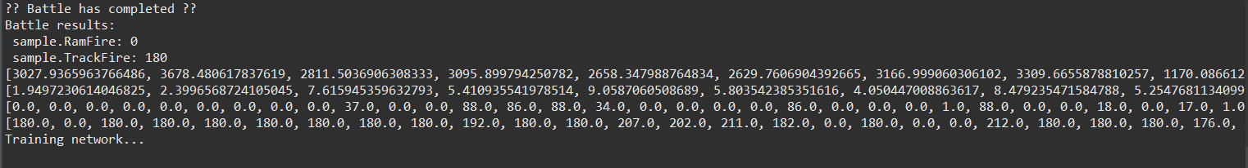
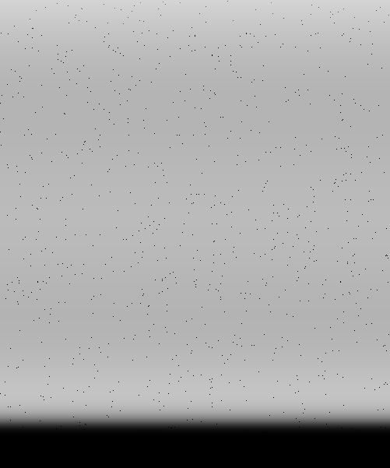

Results
The Results can be seen on the left, with different robots and on the right with robots from the lab, we can see the small pixels being the robots not trained properly yet.
When the properties were made perfect and the robots were trained the dots seem to converge on the picture as it can be seen

Slide 8
Conclusion
One of the most striking facts about neural networks is that they can compute any function at all.
In our case we run 1000 tests on two robots, we changed the robots to see the output for two different robots. We had obtained two images to show the result of the evaluation.aa
As expected the more trainings we had specified the better the robots became, as overtime the proporties are altered and outliers are eliminated to ge the best results.

